Slide 1
Outline of Today’s Discussion
Eta Squared and Power
Between-Subjects Factorial ANOVA in SPSS
Between-Subjects Factorial ANOVA in Excel
Orthogonal Trend Components
Factorial Graphs in Excel - Review

Slide 2
Part 1
Eta Squared,
and Power

Slide 3
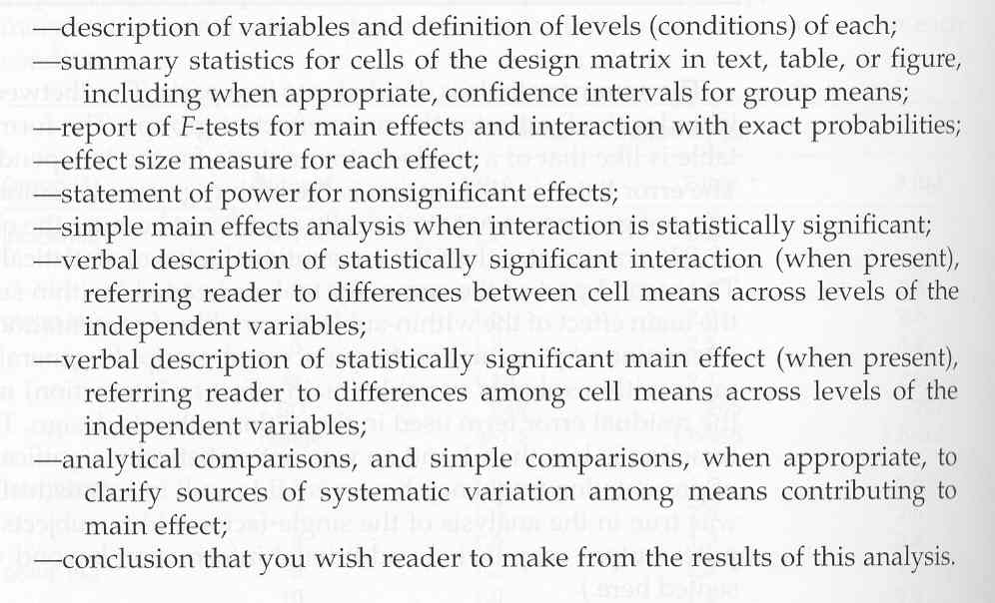
Eta Squared, and Power
Good Reporting Practices

Slide 4
Eta Squared, and Power
One of the “good reporting practices” from the previous slide is providing information effect size…
Effect size - the proportion of variance explained for each effect (i.e., each main effect and interaction).
What other terms have we learned that are synonymous with eta squared?

Slide 5
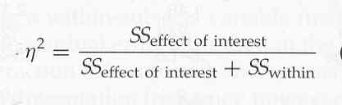
Eta Squared, and Power
Would someone walk us through this?

Slide 6
Eta Squared, and Power
If we had a large value on the left side of this equation,
what might the corresponding pie chart look like?

Slide 7
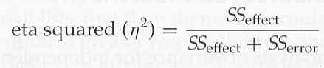
Eta Squared, and Power
Here’s another way of saying the same thing
r-squared and eta squared provide the same info.

Slide 8
Eta Squared, and Power
Now that we’ve developed some intuitions about eta-squared, let’s get some practice computing it…
You sign on to excel while I stay in powerpoint…I’ll show you some F-tables here, and you’ll compute the eta-squared for each effect.
We’ll use the example of the factorial, within-subjects design that we used before. The factors were hand, and task…

Slide 9
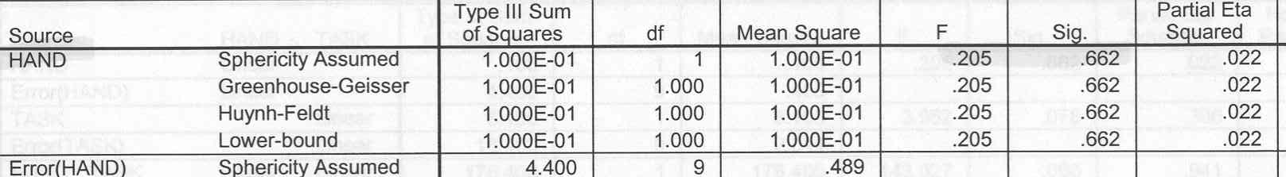
Eta Squared, and Power
Let’s Compute Eta Squared for the “Hand” Factor
SS_{hand} = .1
SS_{error(hand)} = 4.4
SS_{total} = ?
Eta_{squared} = ?

Slide 10
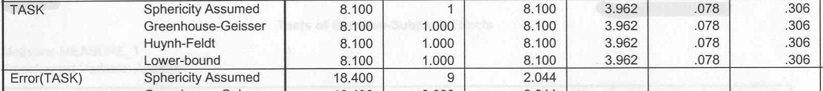
Eta Squared, and Power
Let’s Compute Eta Squared for the “Task” Factor
SS
SS_{task} = 8.1
SS_{error(task)} = 18.4
SS_{total} = ?
Eta_{squared} = ?

Slide 11
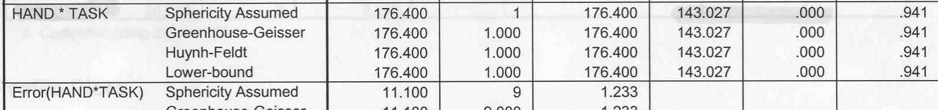
Eta Squared, and Power
Compute Eta Squared for the “Hand-Task” Interaction
SS
SS_{hand x task}= 176.4
SS_{error(hand x task)} = 11.1
SS_{total} = ?
Eta_{squared} = ?

Slide 12
Part 2
Between-Subjects Factorial ANOVA
In SPSS

Slide 13
Part 3
Between-Subjects Factorial ANOVA
In Excel

Slide 14
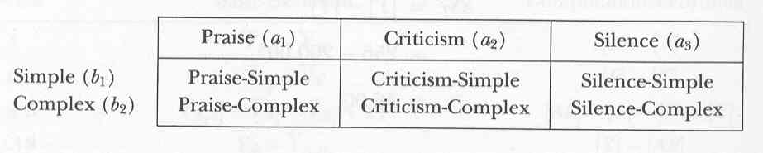
Between-Subjects Factorial ANOVA: Excel
Let’s assume we have a 3x2 design:
3 levels of feedback, 2 levels of complexity.
We can label each ‘cell’ by its
A and B coordinates.
What are the coordinates of “Praise-Complex”?

Slide 15
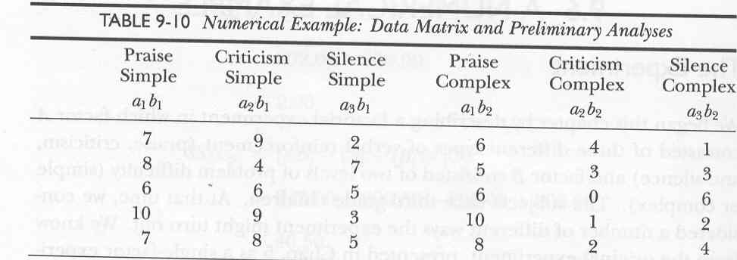
Between-Subjects Factorial ANOVA: Excel
To compute the ANOVA in excel,
each condition should be in a separate column.

Slide 16
Between-Subjects Factorial ANOVA: Excel
What were the three basic ratios that we had learned for the one-way (i.e., one factor) ANOVA?
To manually compute Factorial ANOVAs, we will need TWO new basic ratios.
One for Factor B, and one for the AxB interaction.

Slide 17
Between-Subjects Two-Way ANOVA
[Y]
[Y] = The sum of the individual squared scores.
(Square them first, then sum them.)
[AB]
[AB] = The sum of the individual cells from the Squared AB Matrix,
divided by the number of subjects per condition.
[A]
[A] = The sum of the column totals from the Squared AB Matrix,
divided by (number of B levels * subjects per condition).
[B]
[B] = The sum of the row totals from the Squared AB Matrix,
divided by (number of A levels * subjects per condition).
[T]
[T] = The grand total squared, divided by the total number of scores.
The total number of scores (N) equals a * b * n.
Two “newbies”

Slide 18
Between-Subjects Two-Way ANOVA
The F Table
using basic ratios
Notes:
Source SS DF Mean Square F
Main Effect Factor A [A] - [T] a-1 SSa / DFa MSa / MSerror
Main Effect Factor B [B] - [T] b-1 SSb / DFb MSb / MSerror
AxB Interaction [AB] - [A] - [B] + [T] (a-1)(b-1) SSaxb / DFaxb MSaxb / MSerror
Error Term [Y] - [AB] a * b * (n-1) SSerror / DFerror

Slide 19
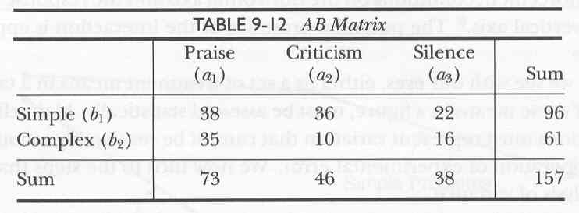
Between-Subjects Factorial ANOVA: Excel
New Twist!
To manually compute basic ratios for factorial designs,
we need to develop the so-called
AB Matrix of sums.

Slide 20
Between-Subjects Factorial ANOVA: Excel
New Twist!
The AB Matrix of sums will
have to be squared.
This is similar to what we’ve done before.

Slide 21
Between-Subjects Factorial ANOVA: Excel
New Twist!
The Basic Ratios in your hand-out
will be based on the squared AB Matrix.
Again, what do Basic Ratios do for us?

Slide 22
Part 4
Orthogonal Trend Components
Review
&
Something New

Slide 23
Orthogonal Trend Components
What does orthogonal mean?
When we have many levels within a single CONTINUOUS variable, we can partition the variability in a new way…
Orthogonal trend components – an analysis in which the variability and the significance associated with each so-called “order” in an polynomial equation are determined. (Huh!)

Slide 24
Orthogonal Trend Components
You recall our buddy the polynomial….
Example: If your senior research has 5 levels on an IV measured on a continuous scale (i.e., ratio or interval scale), you can fit a 4th order polynomial equation. Y = ax⁴ + bx³ + cx² + dx + intercept
In general, for any variable with n levels, you can fit an n-1 order polynomial. Example: 16th order polynomial for 17 levels.

Slide 25
Orthogonal Trend Components
The first-order trend is called ‘linear’.
The second-order trend is called ‘quadratic’.
The third-order trend is called ‘cubic’.
After that, the trends are simply referred to by their number... 4th order trend, 5th order trend, etc..

Slide 26
Orthogonal Trend Components
So why do we use these orthogonal trend components?
It’s all about description!!!
To provide a precise description of our variables, sometimes we want to know whether mathematical trends are significant in our data…

Slide 27
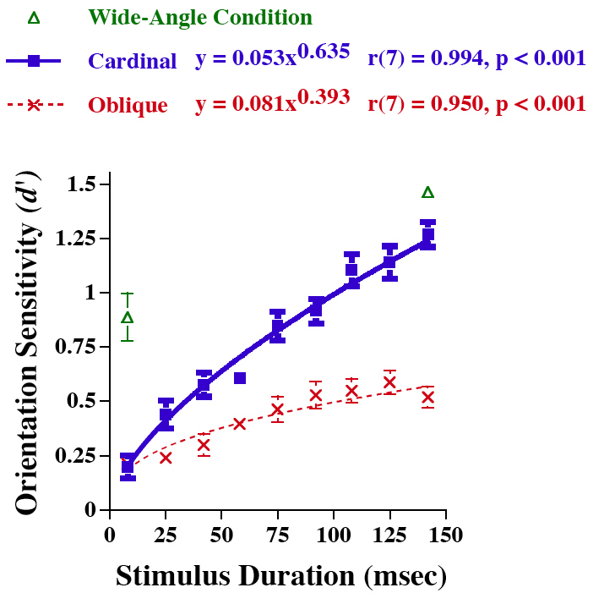
Orthogonal Trend Components
Would someone please describe this graph in our nomenclature,
and state its dimensionality?

Slide 28
Orthogonal Trend Components
Let’s look at the simple effect of stimulus duration,
at just one level of the angle variable (cardinal).

Slide 29
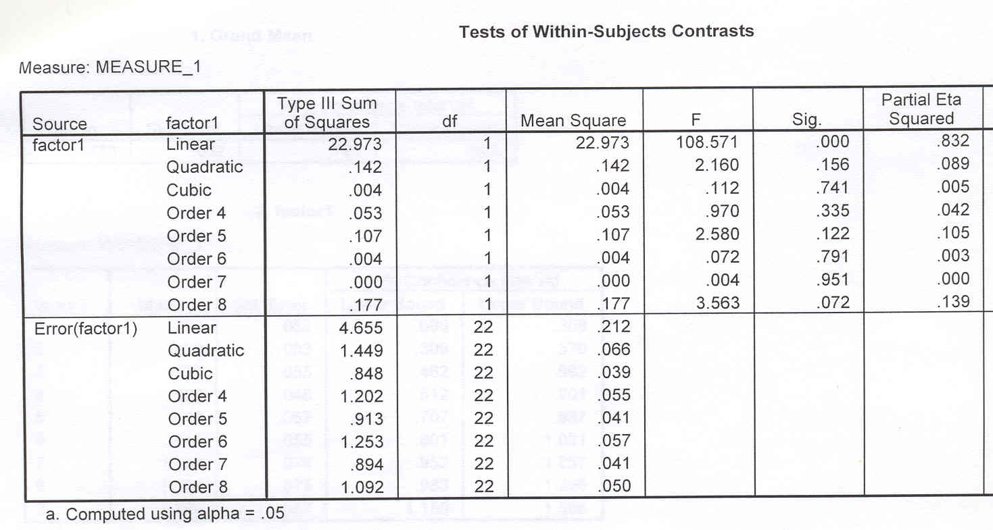
Orthogonal Trend Components
For this analysis, we’ve turned the experiment into a
1-way anova, with 9 levels of duration (8th order polynomial).

Slide 30
Orthogonal Trend Components
SPSS calls its orthogonal trend analysis
“Tests of Within Subjects Contrast”

Slide 31
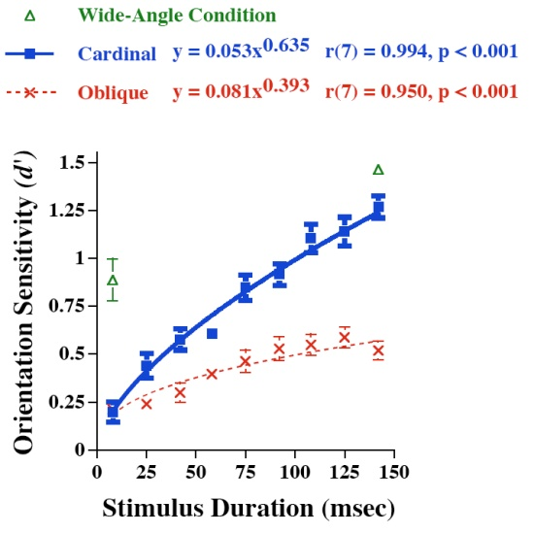
Orthogonal Trend Components
We can also evaluate orthogonal trend components in factorial designs…
The following SPSS output reflects the orthogonal trend components from our earlier graph, but now with 2 levels of the angle variable (oblique and cardinal)….

Slide 32
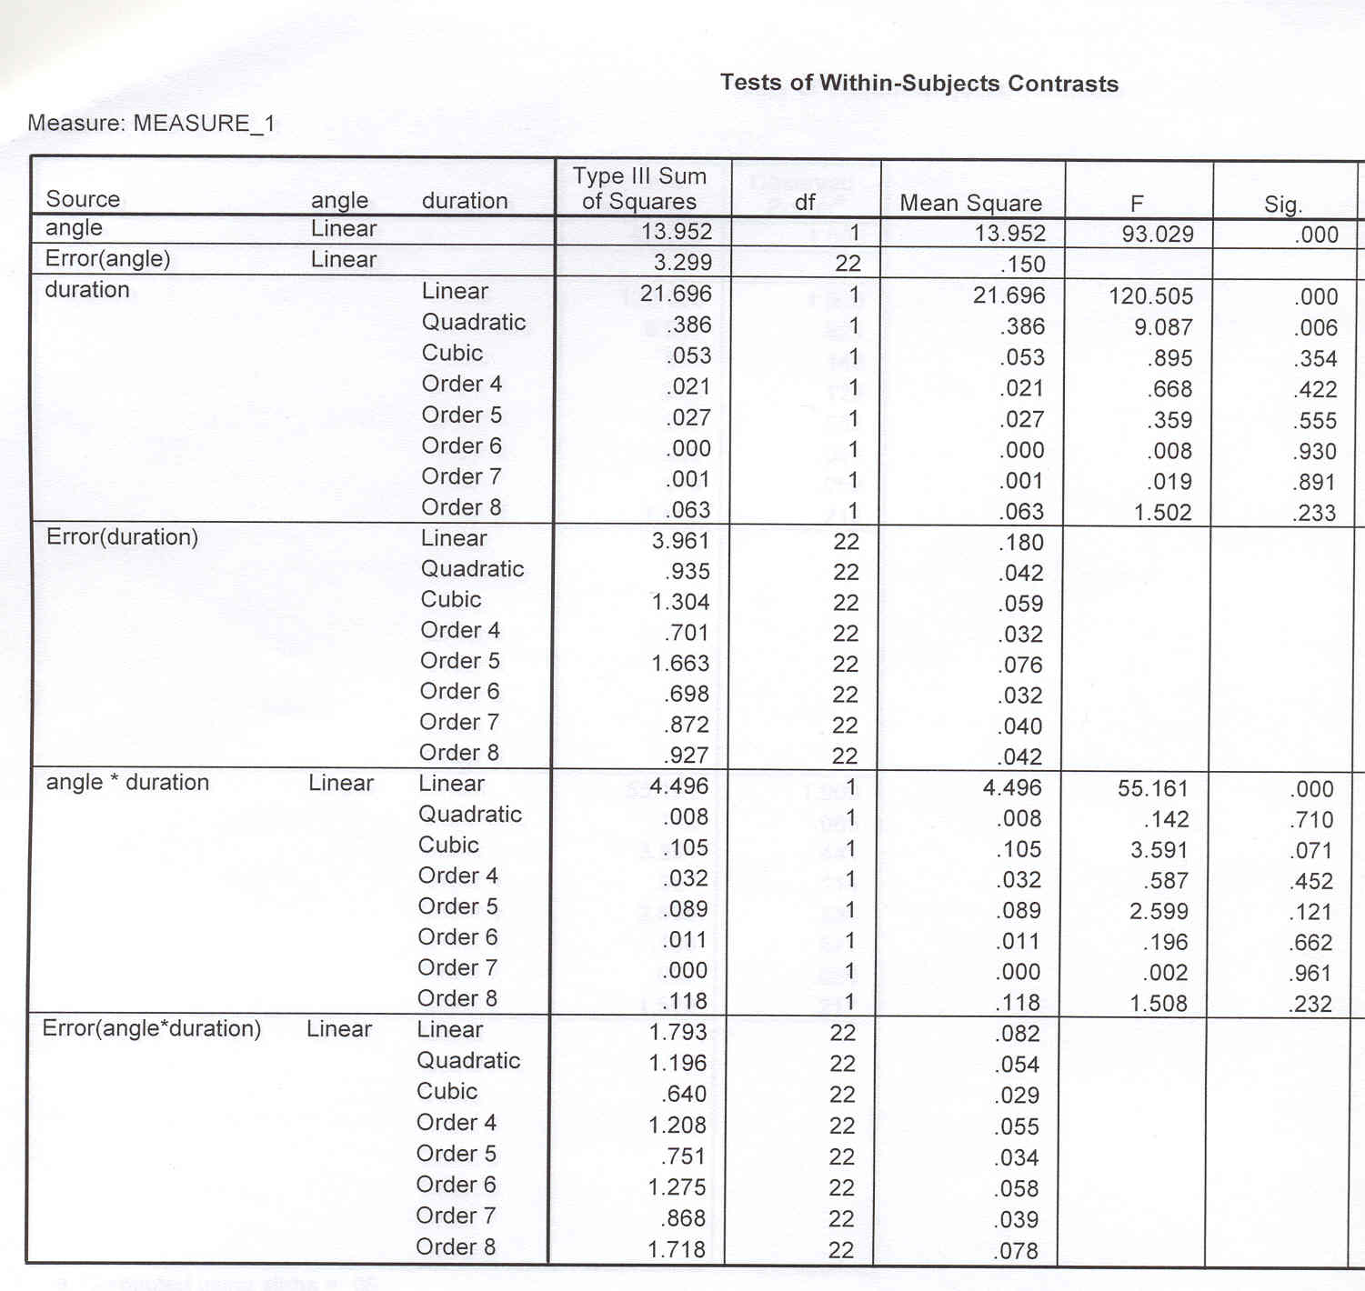
Orthogonal Trend Components
Notice that the
ANGLE variable
has only 2 levels,
so it’s highest order
polynomial is a
(“lowly”) linear.

Slide 33
Orthogonal Trend Components
The output shows
the main effect
of ANGLE is
significant!

Slide 34
Orthogonal Trend Components
The main effect of
Duration is also
Significant.
Specifically, its linear
and quadratic trend
components are
significant.

Slide 35
Orthogonal Trend Components
All the other, higher-
order orthogonal
trend components
are non-significant.

Slide 36
Orthogonal Trend Components
Note: When reporting
the orthogonal trend
components in APA-style
you should report the
F statistic for the trend of
interest, with the
corresponding DFs..
F(1,22)=9.087, p=.006
for the quadratic trend.

Slide 37

Orthogonal Trend Components
OK…now hang on to your hats….
Critical Thinking Question: Intuitively, what would it mean to have, say, a significant linear trend component within the INTERACTION?

Slide 38
Orthogonal Trend Components
OK…now hang on to your hats….
How about a significant Quadratic Trend?

Slide 39
Orthogonal Trend Components
Here, the angle x duration
interaction is significant,
but only the linear trend
in the interaction is
significant…
F(1,22)=55.161, p<0.001
for the linear trend.

Slide 40
Orthogonal Trend Components
Some final thoughts on Orthogonal Trend Components
Linear Trends are very common in psychology.
Also, the combination of linear and quadratic trends is very common. What would that imply?
Can someone think of a meaningful cubic trend?
Good luck if you have to meaningfully interpret something higher than a cubic trend!!!
Cubic trends have two inflection points.

Slide 41
Part 5
Factorial Graphs
In Excel

Slide 42


